Slide 1
ORGANISATIONAL
BEHAVIOUR
CHAPTER-5
PERSONALITY

Slide 2
LEARNING OBJECTIVES
That personality refers to the attributes of an individual which make him or her different from others.
The theories of personality are many, and most important of them are trait, type, psychoanalytic, social learning, self, and self-actualization theories. Each theory seeks to add a new perspective to the nature of the personality.
That personality goes through several stages from the infancy to adulthood stage. Freud, Eric Erikson, Jean Piaget, and Chris Argyris have each contributed to the shaping up of personality.
That heredity, environmental, family, social, and situational factors have contributed to personality.
The “Big five” personality dimensions and Myers-Briggs Indicator seek to explain the structure of personality.
That authoritarianism, machi-avellianism, focus of control, self-esteem, introversion and extroversion, and achievement orientation are the important personality traits relevant to OB.

Slide 3
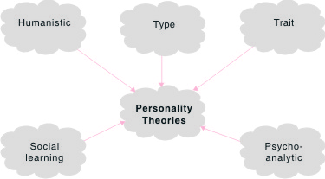
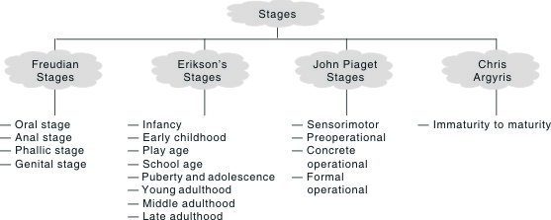
Theories of personality
Shaping of Personality

Slide 4
Freud’s Stages of Personality Development
Stage Age Major Characteristics
Oral 0-1 year Interest in oral gratification from sucking, eating, mouthing,
and biting.
Anal 1-3years Gratification from expelling and withholding faeces; coming
to terms with society’s controls relating to toilet-training
Phallic 3-4 years lnterest in the genitals, coming to terms with Oedipal conflict,
leading to identification with same-sex parent
Latency 4-6 years to Sexual concerns large unimportant
adolescence
Genital Adolescence Re-emergence of sexual interests and establishment of
to adulthood mature sexual relationships.

Slide 5
Erikson’s stages of personality development
Erikson’s Age Success in meeting require- Failure to meet
Stages ments of stage brings requirements of stage brings
1. Infancy Birth to Basic Trust Vs Mistrust
one year Pursuit of affection and Result of consistent abuse, neglect,
gratification of needs, deprivation of love, too early or hard
recognition. weaning, artistic isolation.
2. Early One to three Autonomy Vs Shame & Doubt
childhood years
Child views self as a person Feels inadequate, doubts self, curtails
in his own right apart from learning basic skills like walking, talking,
parents, still dependent. wants to ‘hide’ inadequacies.
3. Play age Four to Initiative Vs Guilt
five years Lively imagination, rigorous reality Lacks spontaneity, infantile jealousy,
testing, imitates, anticipates rallies. suspicions, evasive, role inhibition.
4. School age Six to Industry Vs Inferiority
eleven years Has sense of duty and Poor work habits, avoids strong
accomplishment, develops competition, feels mediocracy, lull
scholastic and social competencies, before the storms of puberty, may
undertakes real tasks, put-fantasy conform as slavish behaviour, sense
and play in better perspective, of futility.
learns world of tools, task
identification.
5. Puberty and Twelve to Ego Identity Vs Role Confusion
adolescence twenty years
Temporal perspective. Self certain. Time confusion, self-conscious, role
Role experimenter. Apprenticeship, fixation, work paralysis, bisexual
sexual polarization, confusion, authority confusion, leaderelellowship, ideological value confusion.
commitment

Slide 6
6.Young Twenty to Twenty Intimacy Vs Isolation
adulthood four years
Capacity to commit self to Avoids intimacy, feelings of social
others. Attitude of care, emptiness and isolation. Seeks respect and responsibility interpersonal encounters which are
towards another. purely formal (employer-employee). Insulate themselves against any type of real involvement. Attitudes of futility and alienation regarding their vocations
7. Middle Twenty-five to Generactivity Vs Stagnation
adulthood sixty-five years
Productive and creative for Egocentric, unproductive, early Self and others, parental invalidism, excessive self-love, personal
pride and pleasure, mature, impoverishment, self-indulgence,
enriches life, estabshshes feeling of hopelessness and and guides to next meaninglesness.
generation.
8. Late Old age Integrity Vs Despair
adulthood (Suns years)
Appreciates continuity of Time is too short, finds no meaning in past, present and future, life, has lost faith in self and others,
fully satisfied. Death not wants second, chance at life-cycle with
feared, ‘wisdom of old age’ more advantages, fears death. Often
comes into being. senile, depressed spiteful and paranoid.

Slide 7
Comparison of Freud’s and Erikson’s Stage Theories
Approximate Freud’s Psychosexual Erikson’s Psychosocial age Stages Stages
First year Oral Basic trust Vs mistrust
2-3 years Anal Autonomy Vs shame, doubt
3-5 years Phallic Initiative Vs guilt
6 years to puberty Latency Industry Vs inferiority
Adolescence Genital Identity Vs role confusion
Early adulthood — Intimacy Vs isolation
Middle age — General activity Vs Self absorption
Late adulthood — Integrity Vs despair

Slide 8
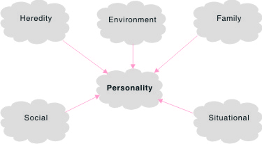
Determinants of Personality

Slide 9
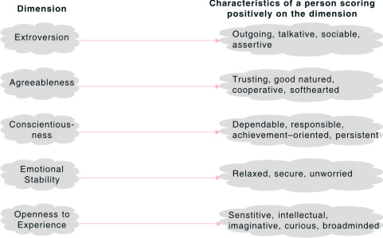
The ‘Big Five’ Personality Traits

Slide 10
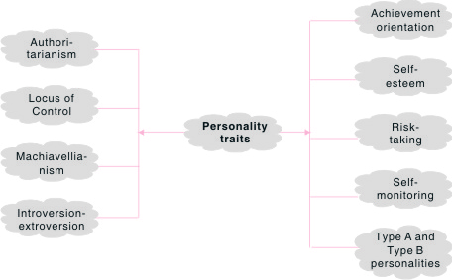
Personality Traits

Slide 11
Some Ways in Which Internals Differ From Externals
Characteristics of Immaturity Characteristics of Maturity
  (i) Information processing: Internals make more attempts to acquire information, are better at information retention, are less satisfied with the amount of information they possess, are better at utilizing information, and devising and processing rules.
  (ii) Job satisfaction Internals are more satisfied, less alienated, and less rootless.
  (iii) Self-control and risk behaviour: Internals exhibit greater self-control, are more cautious, engaged in less risky behaviour.
  (iv) Expectations and results: Internals are a stronger relationship between what they do and what happens to them, expect working hard leads to good performance, feel more control over how to spend time, perform better.
  (v) Preference for skill versus chance: Internals prefer skill-achievement outcomes, externals prefer chance achievements.
  (vi) Use of rewards: Internals are more likely to use personally persuasive rewards and power bases and less likely to use coercion.
  (vii)Response to others: Internals are more independent, more reliant on own judgments, and less susceptible to influence of others, they resist subtle influence attempts and are more likely to accept information on merit rather than prestige of source.
  (viii)Leader behaviour: Internals prefer participative leadership, externals prefer directive.

Slide 12
Locus of Control and Performance
Conditions Performance
Information processing
• The work requires complex information processing Internals perform better
and complex learning
• The work is quite simple and easy to learn Internals perform no better than externals
Initiative
• The work requires initiative and independent action Internals perform better
• The work requires compliance and conformity Externals perform better
Motivation
• The work requires high motivation and provides Internals perform better
valued rewards in return for greater effort, incentive
pay for greater productivity
• The work does not require great effort and contingent Externals perform atleast as well as internals rewards are lacking, hourly pay rates
determined by collective bargaining
·
·
·
·
·
·

Slide 13
Summary
        Personality refers to the internal and external traits of an individual which are relatively stable and which make the individual different from others.
        According to type theories, personalities are categorized into groups based on physical features and psychological factors.
        The traits theory seeks to catagorise people based on their traits.
        Freud’s psychoanalytic theory seeks to explain personality as comprising id, ego, and superego.
        The social learning theory emphasizes the process of learning. Situation is considered to be an important determinant of behaviour.
        Roger’s self theory lays emphasis on how an individual perceives the world around and the self.
        Maslow’s self-actualization theory is based on existential philosophy.
        Existential philosophy is concerned with man as an individual and each person is responsible for his own existence.
        Freud was the first person to suggest that personality goes through oral, anal, phallic, and genital stages.
        Erik Erikson developed eight stages which he claimed could describe the development of personality.
        Jean Piaget and Chris Argyris have also contributed to the shaping of personality.
        Personality is the product of heredity, environment, family, social, and situational factors.
        The ‘Big Five’ personality traits includes extroversion, agreeableness, conscientiousness, emotional stability, and openness of experience.
        The Myres-Briggs Type Indicator (MBTI) is highly usefu1 in hiring the right people for the right jobs. Authoritarianism, locus of control, Machiavellianism, introversion and extroversion, risk-taking, self-esteem, and achievement orientation are other dimensions of personality that are highly relevant to OB.
        Understanding personality is very important as it influences behaviour, as well as perception and attitudes. Personality profiles help categorize people and predict their performance too.

Slide 14
Key Terms
Workforce diversity
Competitive advantage
Personality
Trait theory
Psychoanalytic theory
Social learning theory
Self-theory
Self-actualization theory
Oral stage
Anal stage

